Slide 1
Prep:
Resources: https://github.com/isidore/Talks/blob/master/StrongStylePairProgramming.md
Feedback: https://forms.gle/agGpTvyHBvSvS2XZA
Menti 1 :
https://www.mentimeter.com/s/da8d1b21f013aefa7920193aa5489aab/fc2b0cb2c2a3
https://www.menti.com/hjvwub73o8
Menti 2:
Menti 3:
https://www.mentimeter.com/s/e1c818088876a42048161a2999a86aff/de7ad9f80bea
Notes:
Given At:

Slide 2
Better Together
use cases for pair programming…
@LlewellynFalco

Slide 3

Resources

Slide 4
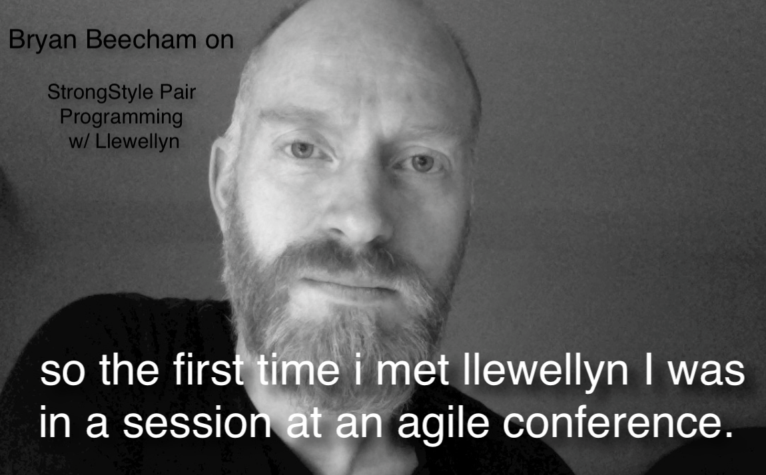


Slide 5
Programmer
Noun [proh-gram-er]
An organism that converts caffeine into code

Slide 6
Los Alamos New Mexico, USA

Slide 7
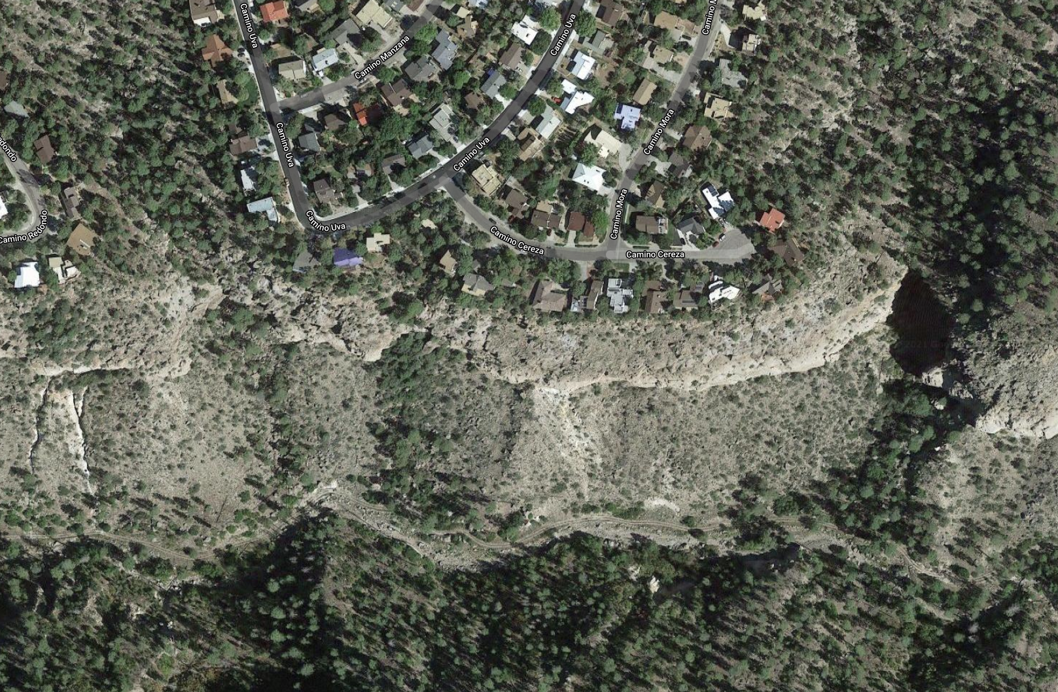

Los Alamos New Mexico, USA

Slide 8
We all want to be
Better
… but there are obstacles

Slide 9
Stories
3
from my neighbor…
Helping
- Learning
- Best Result

Slide 10
I’ve been meaning to…
New Practices
New Language
New Package
New Tooling
New Behavior
TDD
CI / CD
Definition of Done
Refactoring
Full Quality
Documentation
Code Reviews
UX
Testing
Procrastination

Slide 11
Better Version of myself
Notes:
hetero economics theory

Slide 12
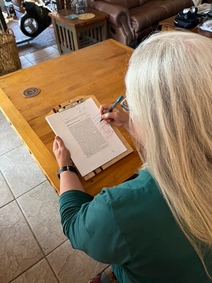
Indexing Hetero-economics theory
@LlewellynFalco

Slide 13
They are paying for your attention

Slide 14
Potential: Kate (solo)

Slide 15
Potential: Kate (solo)

Slide 16
Potential: Kate + 1 Hour of Llewellyn

Slide 17
Potential: Kate + 1 Hour of Llewellyn

Slide 18
Accountability Buddy
Kate
Me

Slide 19
Accountability Buddy
Kate
Me

Slide 20
Learning

Slide 21
Mentor/Mentee
On-Boarding
New Employee
New Team member
Up-Skilling
Skills
Technology
Take time to Reflect

Slide 22
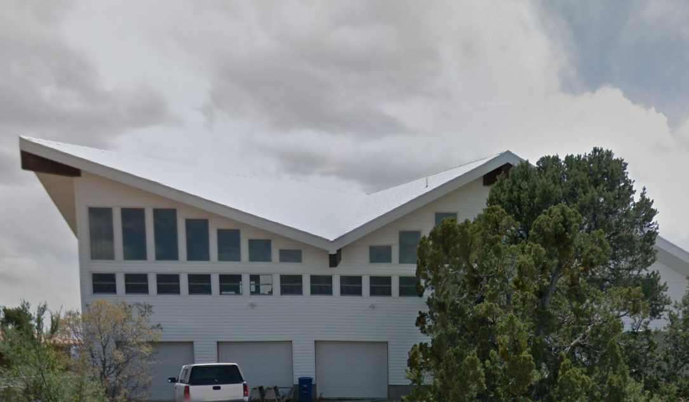
Bob (the builder)

Slide 23
I just need to sit down for a bit

Slide 24
he just makes it look so easy

Slide 25
Mentor / Mentee
Bob
Me

Slide 26
Mentor / Mentee
Bob
Me

Slide 27
Creating
Cross-Functional
Different sections of code
Different Specialty
Different Jobs
Wicked Problems
Important Problems

Slide 28
Creating

Slide 29
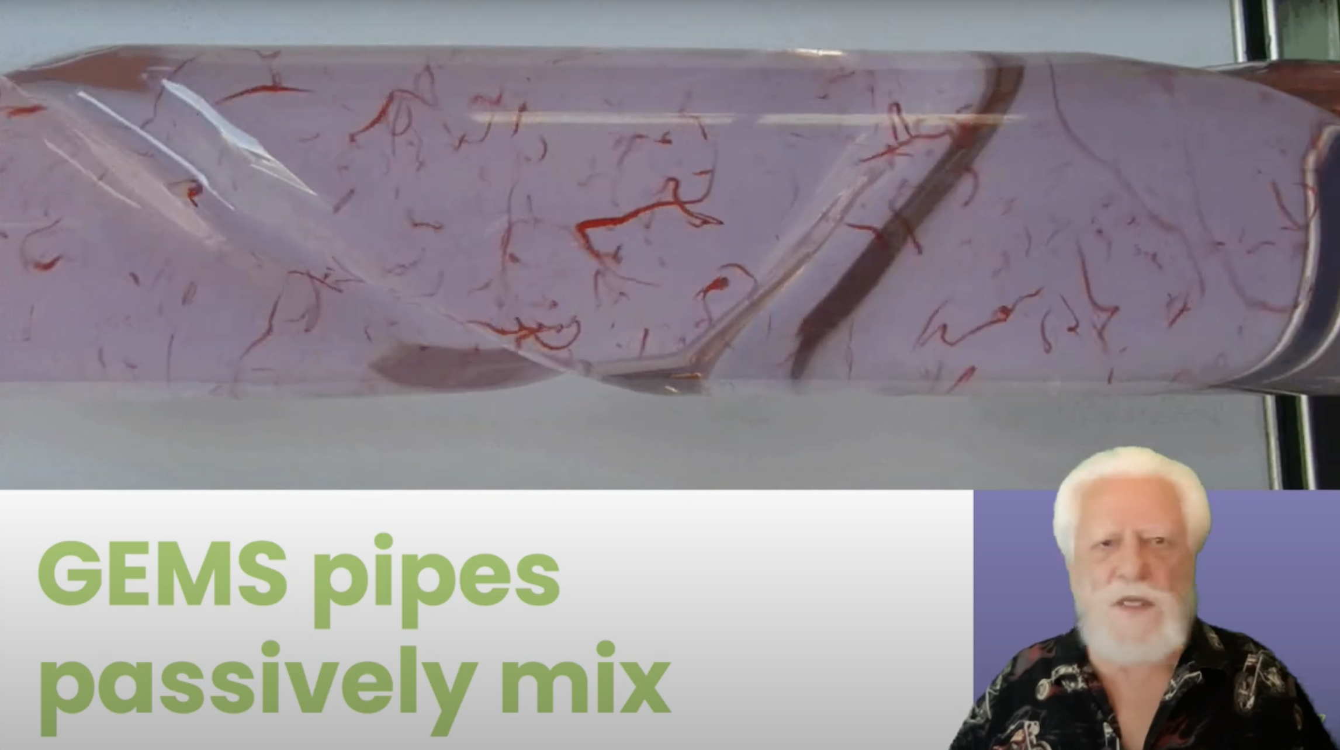
Algae Growth YouTube video

Slide 30
Just try it

Slide 31
Best of Both
Algae
Presentation Skills
CO₂ Consumption
Ethanol Plants
S
Green Screen
Fluid
Dynamics
Same Location
YouTube
GEM reactors
O
Fertilizer
Powerpoint
Science
Camtasia
Recording

Slide 32
Co-Creation
Bob
Me

Slide 33
Pairing Problems
Attention (1 person working, 1 person watching)
Intensity
Misunderstanding
Head Butting + Trust

Slide 34
Strong Style Pairing
“
For an idea to go from
your head to the keyboard
it must go through
someone else's hands
”

Slide 35
Traditional Pairing
“
I have an idea, let me take the keyboard
”
Strong Style Pairing
“
I have an idea, please take the keyboard
”

Slide 36
Problems
Attention (1 person working,
1 person watching)
If both people aren’t engaged nothing can happen
Misunderstanding
The other person must understand well enough to do it.
Learning
The less experienced person is mainly on the keyboard.
Head Butting
“Disagree and commit”
Intensity
Pomodoro’s and time limits

Slide 37
Intent
Location
Details
Save the file
In the upper right menu bar
Move the mouse up (1 inch) & left click on the disk icon

Slide 38
Trust
give me 5 minutes…

Slide 39





Slide 40
Resources
Notes:
https://github.com/isidore/Talks/blob/master/StrongStylePairProgramming.md

Slide 41
We all want to be
Better
Help / Learn / Produce
Notes:
Who can you help on your team?
Who do you need to ask for help?

Slide 42
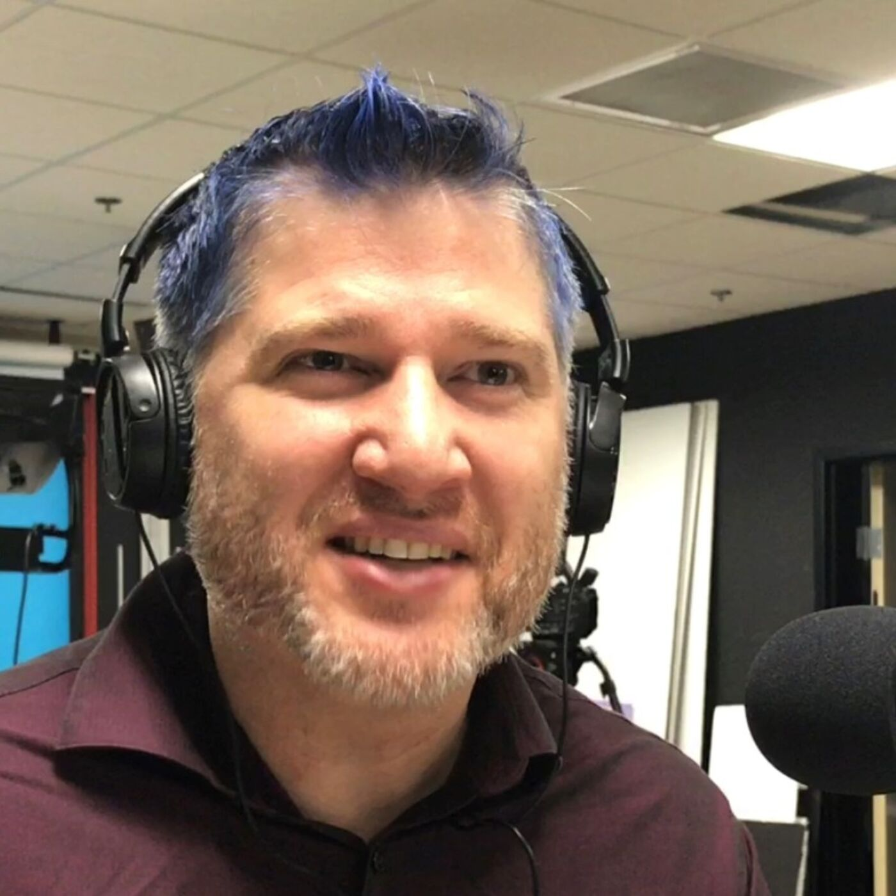

Thanks!
Please connect on Twitter & LinkedIn
@LlewellynFalco
LlewellynFalco.Blogspot.com
www.approvaltests.com
Slide template by:

